Slide 1
Robot Warehouse Navigation
Georgia Institute of Technology CS 8803-001 Artificial Intelligence for Robotics
Summer 18
James Chan
Source code sharing subject to Georgia Tech Honor Code restriction. Available for private viewing upon request.

Slide 2
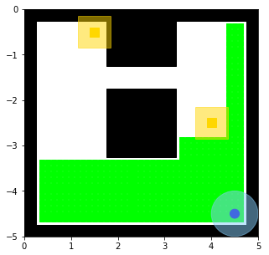
Overview
Problem Statement:
Devise a program to navigate a robot within a simulated warehouse. The goal of the robot is to collect all the boxes and bring them back to the drop zone. Any collision with walls or boxes are considered failure. The quicker (shorter path) the robot can collect all the boxes, the higher score the student receives. The program must work in various warehouses and box arrangements. Exploration is not necessary – the robot already have knowledge of the locations of the boxes ahead of time. The robot can only carry one box at a time.
Boxes to be picked up
Robot should take caution to not travel into LIGHT YELLOW region in order to prevent collision
LIGHT BLUE region
represent the reach of the robot.
BLACK region are walls
Robot, also the initial
position as well as
drop zone
GREEN region represent all the position the robot can move to in a straight line. Think more or less like the vision of the robot.

Slide 3
Solution
To calculate the optimal path, the map of the warehouse is discretized into grids and A* is utilized to search for the path with the shortest cost. The use of numpy and carefully selected heuristic function (continuous linear distance from the box) contributes significantly to the efficient performance of the program. Visualization generated with matplotlib.
Heuristic function
Heuristic function
Calculate path
Optimal/near-optimal path

Slide 4
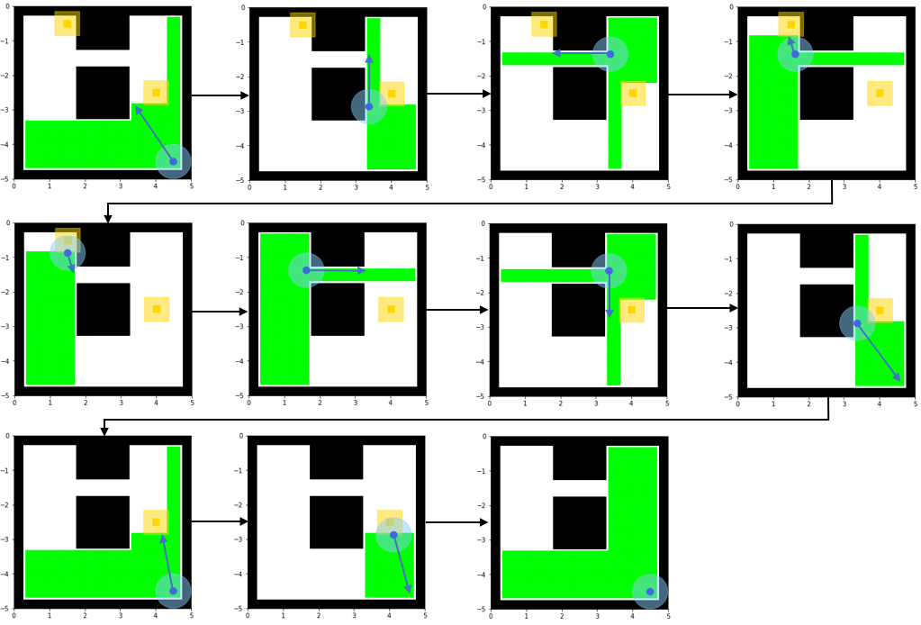
Trial Run – Warehouse #1
Start
Complete

Slide 5
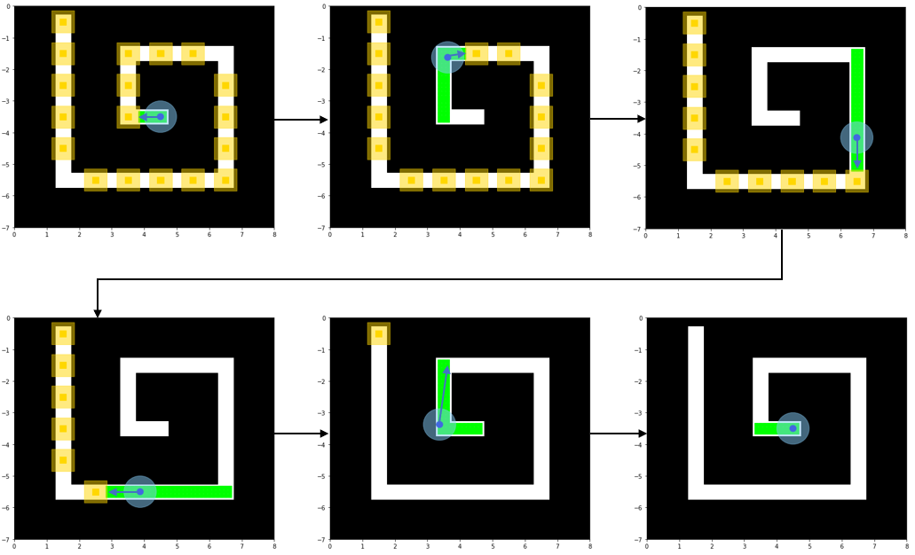
Trial Run – Warehouse #2
Start
17th Step
61th Step
124th Step
200th Step
Complete

Slide 6
Conclusion
The robot was able to discover near-optimal, and in many cases, optimal path. Finer resolutions of gridding may be used to improve the probability of discovering optimal solution at the cost of higher time complexity. Planning algorithms such as value iterations or policy iteration also have merit in solving this problem.

